Slide 1

Project Title – Netflix Major_project-Content Trends Analysis for Strategic Recommendations
Student Name :Gummadi Pradeep Kumar Shishira
AICTE Internship ID- INTERNSHIP_17546440516895be537820f

Slide 2

PROBLEM STATEMENT
Netflix has become one of the most prominent global streaming platforms, continuously expanding its library with a mix of original productions and licensed content. However, with growing competition from platforms like Amazon Prime, Disney+, and regional OTT providers, Netflix must strategically analyze its content catalog to identify strengths, gaps, and opportunities.
The specific problem to be addressed in this project is 'Content Trends Analysis for Strategic Recommendations'. The aim is to uncover how Netflix’s content distribution (Movies vs. TV Shows, genres, and country contributions) has evolved over the years. This will enable the identification of key genres, audience preferences, and strategic insights into global content expansion.

Slide 3
Project Description- Title: Netflix Content Analysis Project Objective: To analyze the Netflix catalog to identify content trends. Dataset: ~7,800 titles including Movies & TV Shows, with metadata (director, cast, country, release date, rating, duration, and genres). Key Questions Addressed: Distribution of Movies vs TV Shows over time. Most common genres and their popularity trends. Country-wise contributions to Netflix content. Insights help Netflix make data-driven decisions on content strategy, investments, and localization.

Slide 4

WHO ARE THE END USERS?
Netflix Content Strategy Teams → Decide what genres and markets to focus on.
Marketing Teams → Promote popular genres and target regions.
Data Analysts & Business Intelligence Teams → Build dashboards & track content KPIs.
Regional Managers → Identify opportunities in underrepresented countries.
Executives/Decision Makers → Align investments with global viewing trends.

Slide 5

Technology Used
Python 🐍 – Core programming language for data analysis
Jupyter Notebook 📓 – Interactive environment for coding & documentation
Pandas, NumPy – Data cleaning, manipulation & numerical analysis
Matplotlib, Seaborn – Data visualization and statistical graphics
Excel / CSV – Dataset handling and preprocessing

Slide 6

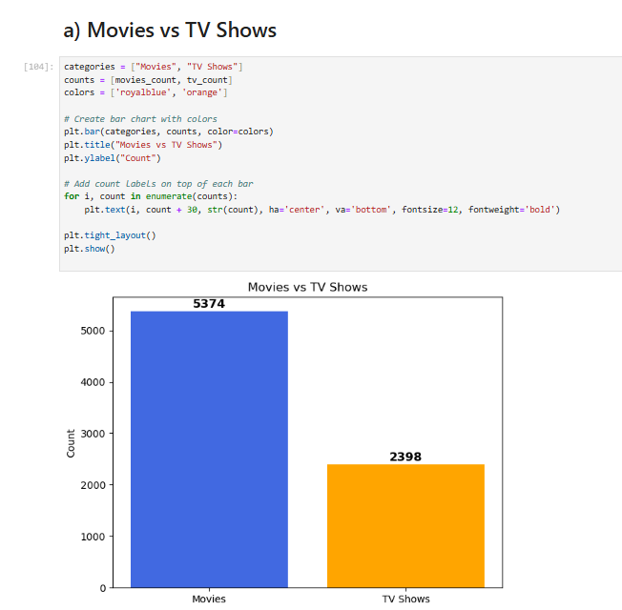
RESULTS1

Slide 7

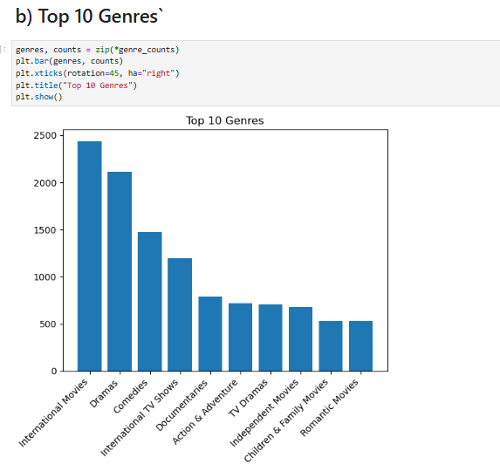
RESULTS2

Slide 8

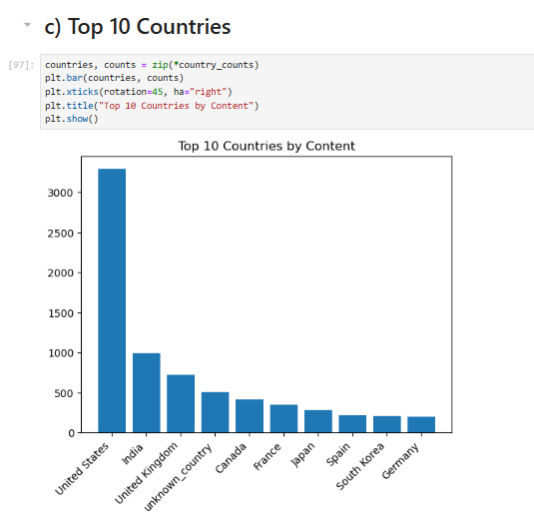
RESULTS3

Slide 9
GitHub repository
https://github.com/shishira-sagar/VOIS_AICTE_Oct2025_MajorProject_Shishirasagar.git

Slide 10
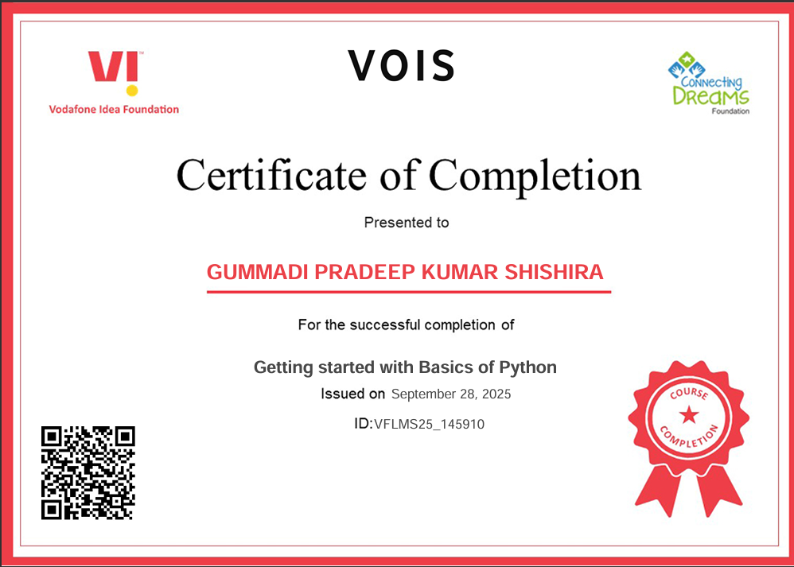
Getting started with Basics of Python Certificate

Slide 11
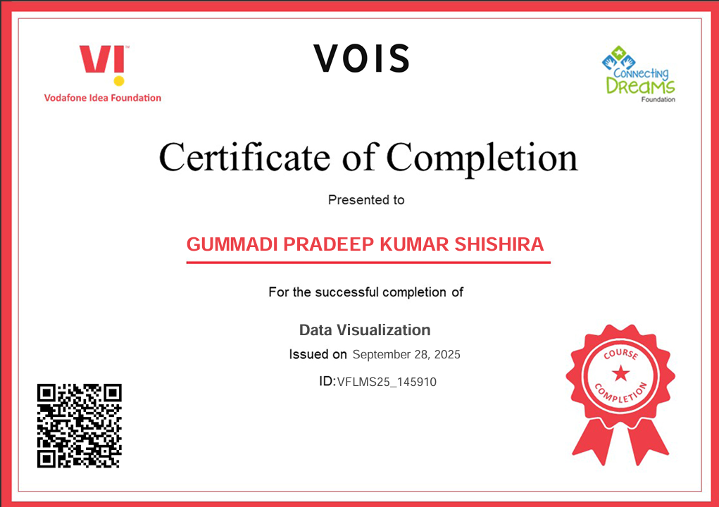
Data Visualization Certificate

Slide 12
Thank you
.
.

